Slide 1
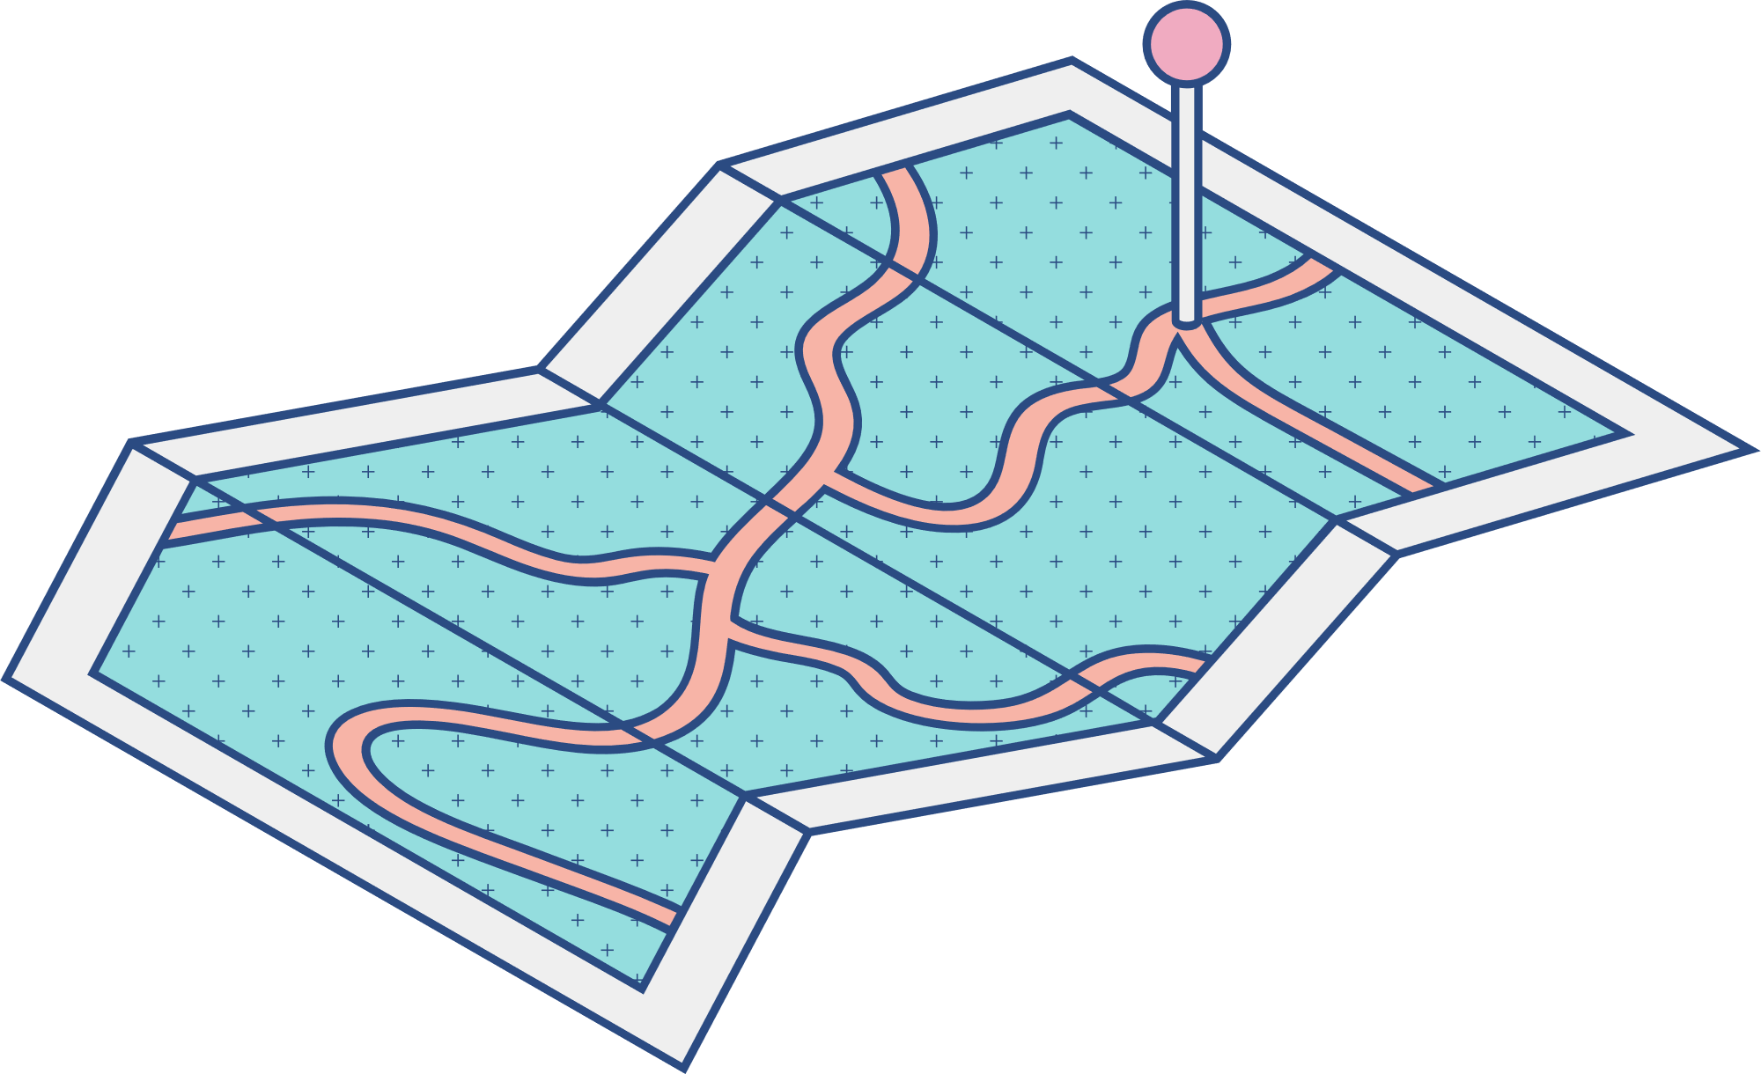





UNDER THE GUIDANCE OF
PROF. CHINTAN BHATT
Smart Attendance System
with face recognition technique
Team:
Sahaj Bhadja (20BCP151)
Vishwa Gajjar (20BCP171)
Dhruv Patel (20BCP152)

Slide 2

AGENDA
Abstract
Literature Survey
Dataset Description
Related Work
Simulated methodology
Challenges
Outcomes and Conclusion
References
Introduction

Slide 3


Abstract
In the time where everything is being digitalized, the manual system of attendance marking seems to be time consuming and obsolete.
The proposed system focuses on optimizing the attendance systems by reducing time as well as paper consumption.
The piles of papers stored as a record for attendance can be eliminated using the digital systems.
Also, the human errors caused in attendance marking or the intentional frauds / proxy systems can be eliminated using digitalized systems.

Slide 4

Introduction
The proposed system uses facial recognition system for
attendance marking.
Face detection is a type of bio metric technique used to detect faces automatically by computer vision systems.
On the basis of face identity, the person will be identified and marked as present.
The time required for the face detection will be less as compared to manual marking, and also the need of an authorized person for marking attendance will be eliminated.

Slide 5
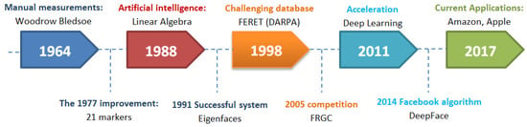
In 1960s, mathematician and computer scientist Woodrow Wilson Bledsoe first developed a system of measurements that could be used to put photos of faces in different classifications. Because of this work, Bledsoe is known as the unofficial father of facial recognition technology.
Literature
Survey
The below figure shows the evolution of face recognition technology over time:
(Reference: Adjabi, I.; Ouahabi, A.; Benzaoui, A.; Taleb-Ahmed, A. Past, Present, and Future of Face Recognition: A Review. Electronics 2020, 9, 1188. https://doi.org/10.3390/electronics9081188)

Slide 6
Literature Survey contd.
Sr. No. | Authors | Title | Proposed method and techniques | Publication year
1 | Bledsoe W.W. | The Model Method in Facial Recognition | Facial recognition computer programming | 1964
2 | Alex Pentland Matthew Turk | Eigenfaces for recognition | Eigenfaces, statistical Principal component analysis (PCA) method. | 1991
3 | Phillips, P.J. Flynn, P.J. Scruggs, T. | Overview of the face recognition grand challenge | Was a review of the Face Recognition Grand Challenge (FRGC) competition | 2005
4 | Guo G. Zhang, N | A survey on deep learning based face recognition | Computer vision image understanding | 2019
5 | Taigman, Y. Yang M. Ranzato M. | Deepface: Closing the gap to human-level performance in face verification. | Computer Vision and Pattern Recognition | 2014

Slide 7
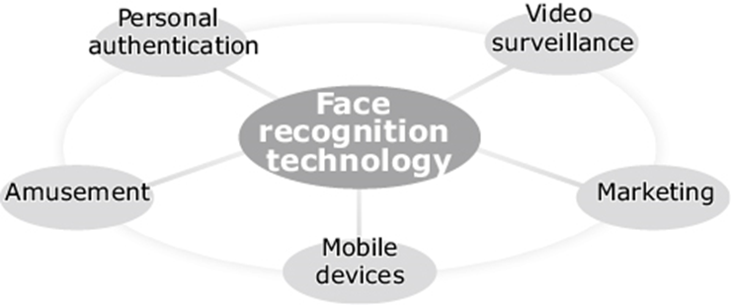
Related work
Facial Recognition systems used for unlocking of phone with a facial scan or facial image while going through airport security.
Face detections are used in Proctored Online Exams.
Example: PEXA

Slide 8
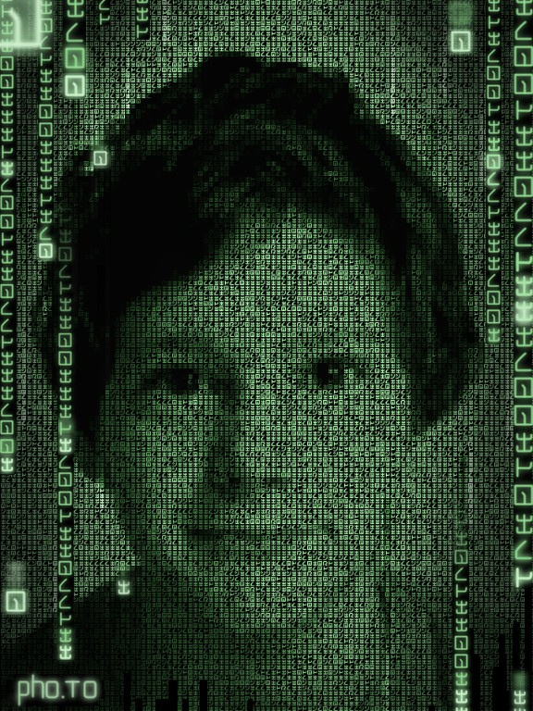
The dataset consists of the identified facial images of people.
We are converting the image to the NumPy N-D array file and store it in a database for the further detection in the form of .npy file.
In a recognizer we fetch the NumPy file from the databases and match it with the current face pixels and return the name.
The images are balanced with respect to distance to the camera, alternative sensors, frontal versus not-frontal views, and different locations.
Dataset
Description

Slide 9
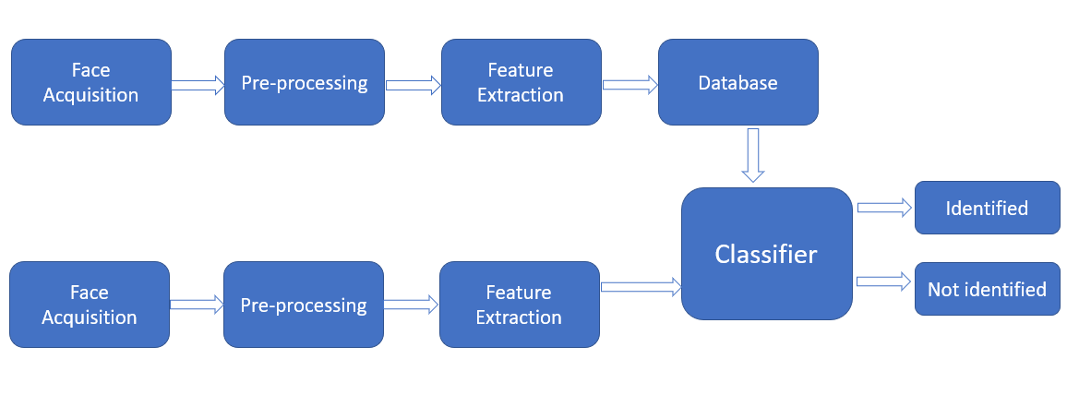
Methodology
openCV (open computer vision)
The software uses OpenCV. OpenCV (Open Source Computer Vision Library) is an open source computer vision and machine learning software library which detects the face stores it in the database and recognize the face image

Slide 10
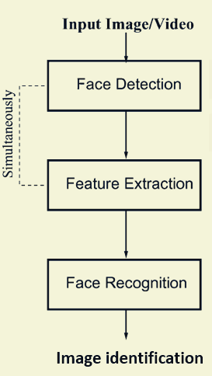
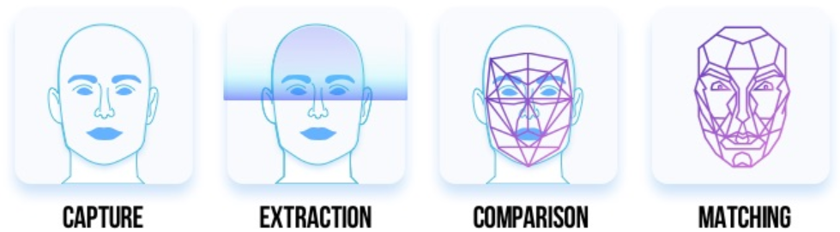
Methodology contd.
A picture is captured.
Software reads the geometry of your face. (Creates facial signature.)
Facial signature compared to the database of known faces.
A determination is made

Slide 11
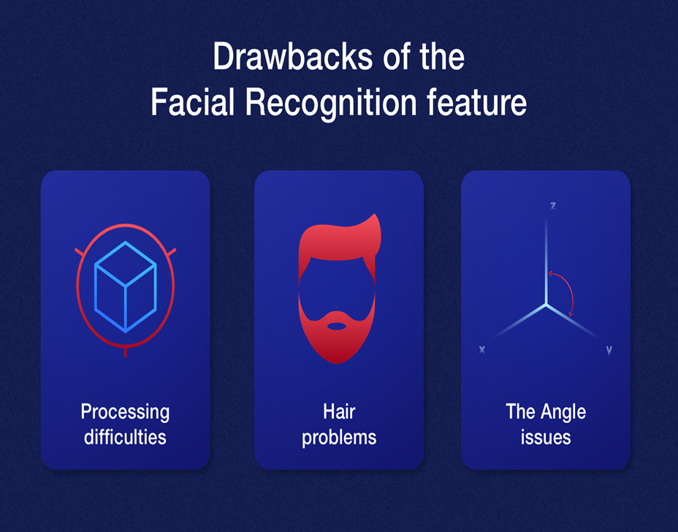
Challenges
faced
Misalignment
Pose variation
Illumination variation
Expression variation
Intensity of light

Slide 12
Results and Conclusion
Confusion matrix for image recognition
From the testing results, the overall accuracy of the system for face recognition from images obtained: 91.7%
Number of face recognitions |  |  | Result
Person 1 | Person 2 | Person 3 | Result
17 | 1 | 2 | Person 1
1 | 18 | 1 | Person 2
0 | 0 | 20 | Person 3
Multiple photos either in group or individual are loaded into system to verify the accuracy. A person should had appeared in those photos for 20 times. When the photos are all tested with the proposed face recognition system, the data is computed in confusion matrix to calculate the accuracy of the system.

Slide 13
References
Bledsoe, W.W. The Model Method in Facial Recognition; Technical Report; Panoramic Research, Inc.: Palo Alto, CA, USA, 1964. [Google Scholar]
Taigman, Y.; Yang, M.; Ranzato, M.; Wolf, L. Deepface: Closing the gap to human-level performance in face verification. In Proceedings of the 2014 IEEE Conference on Computer Vision and Pattern Recognition, Columbus, OH, USA, 23–28 June 2014; pp. 1701–1708. [Google Scholar]
Turk, M.; Pentland, A. Eigenfaces for recognition. J. Cogn. Neurosci. 1991, 3, 71–86. [Google Scholar] [CrossRef]
James Andrew Lewis, How Does Facial Recognition Work?, 2021, Center for strategic and international studies
Guo, G.; Zhang, N. A survey on deep learning based face recognition. Comput. Vis. Image Underst. 2019, 189, 10285. [Google Scholar] [CrossRef]

